Slide 1
Foundation of computer science
By : Mohamed Agami

Slide 2
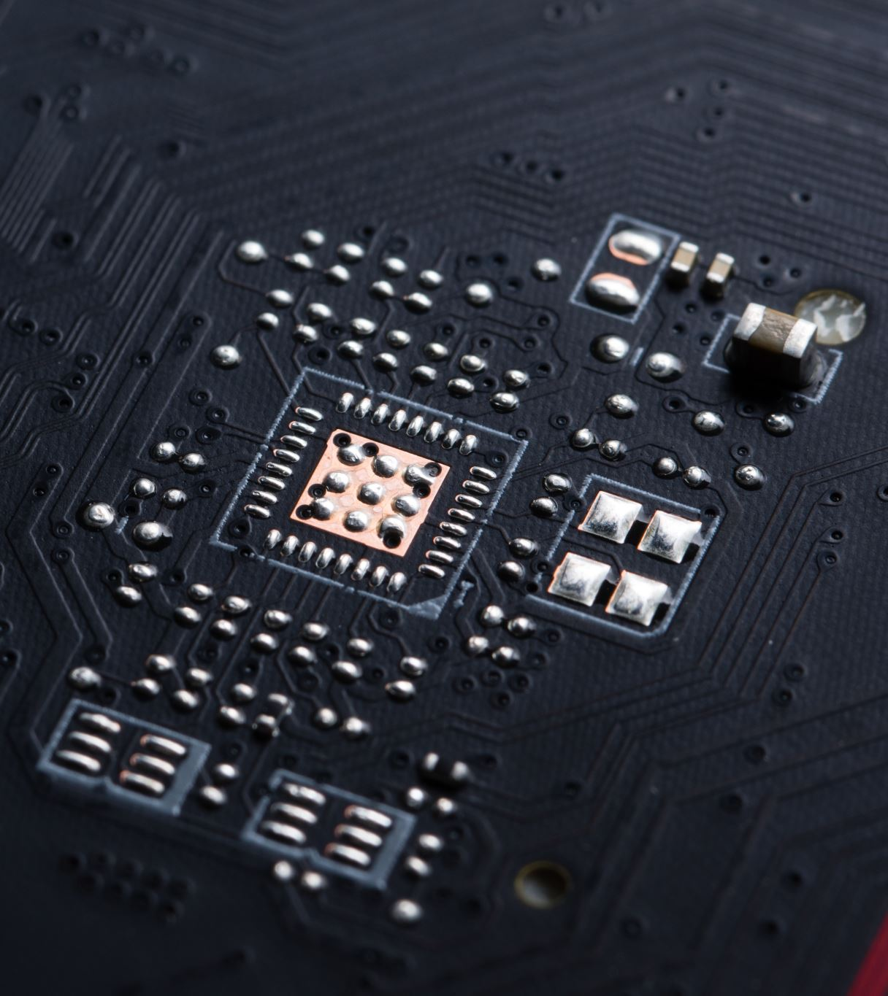
Lecture 4 (part 1)
Motherboard

Slide 3
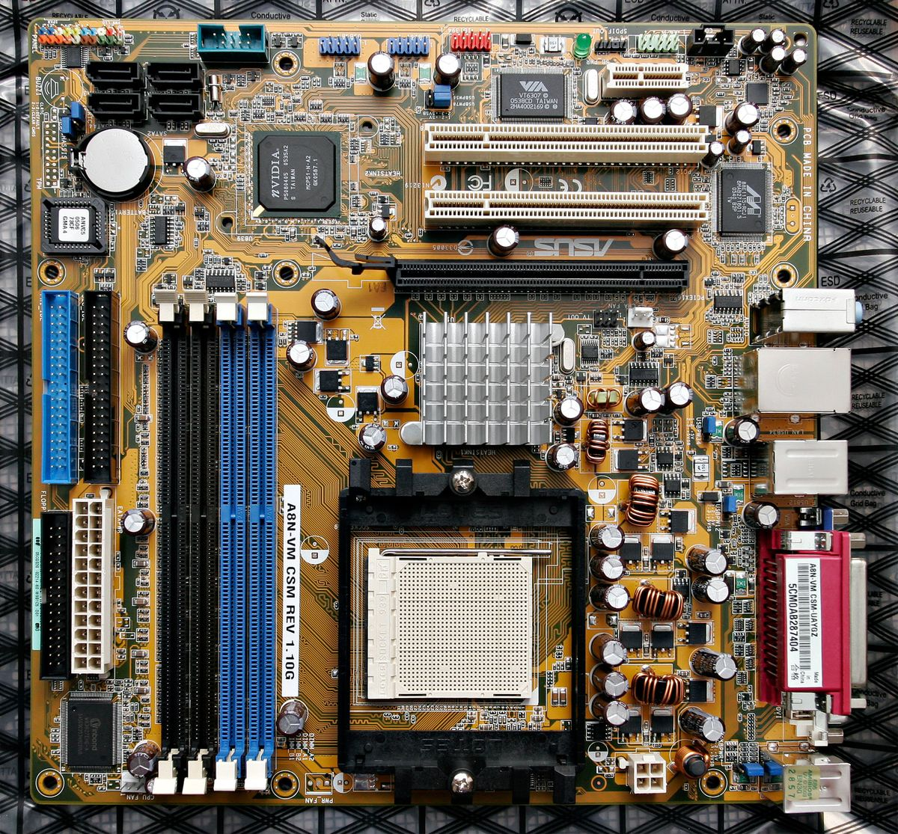
Motherboard
Communication tool
Power distribution

Slide 4
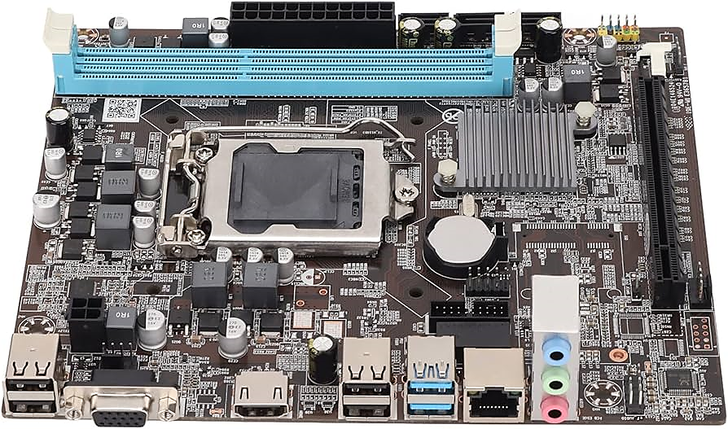
Form factor
Processor Socket
Chipsets
Buses & Slots
1/0 posts
Extra feature

Slide 5
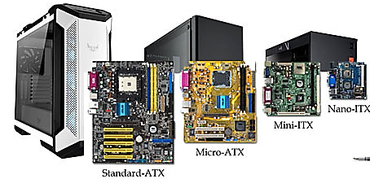
Form factor
ATX => 12 * 9.6 Inch
Micro-ATX => 9.6 *9.6 Inch
Mini-ITX => 6.7 * 6.7 Inch
Nano-ITX = > 4.7 * 4.7 Inch

Slide 6
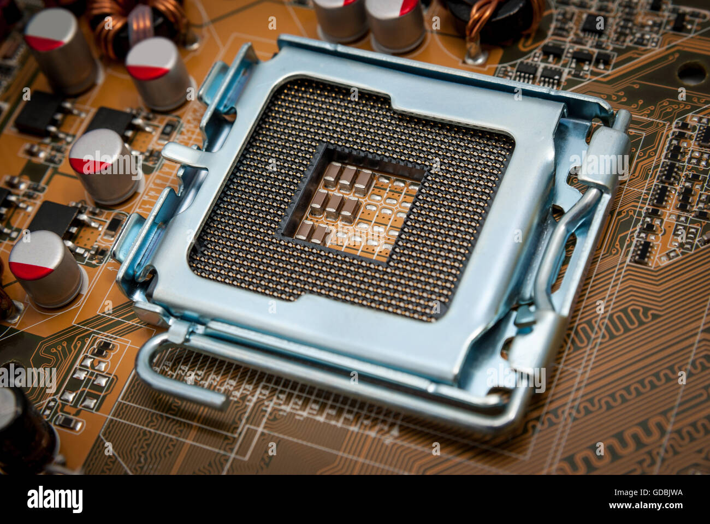
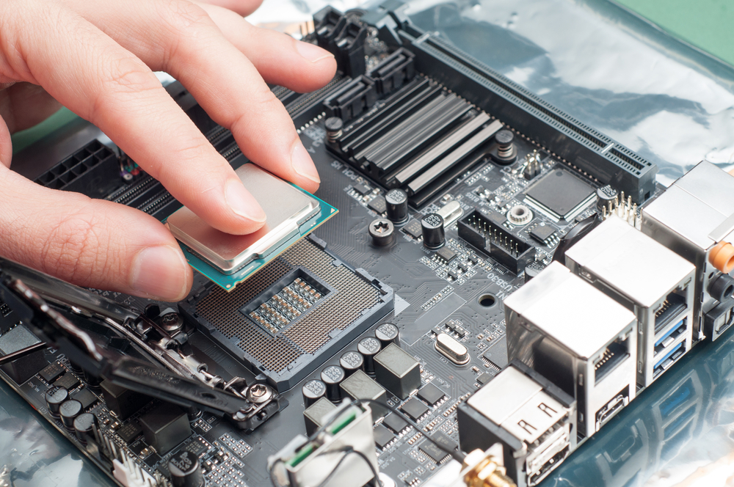
Processor Sockets

Slide 7
Processor Sockets

Slide 8


Processor Sockets

Slide 9
Processor Sockets (Intel)
CPU Sockets Name
Used Processor family
LGA 2066
10th Gen Core
LGA 1200
10th Gen Core
LGA 1151
9th Gen Core, 8th Gen Core
LGA 1150
Four Generation (core i7, core i5 , core i3, Pentium, Celeron)

Slide 10
Processor Sockets (Intel)
CPU Sockets Name
Used Processor family
LGA 1155
Third Generation (core i7, core i5 , core i3, Pentium, Celeron)
LGA 2011
Second Generation (core i7, core i5 , core i3, Pentium, Celeron)
LGA 1151
Core 2 extreme, Core 2 Quad, Core 2 Dou, Pentium dual core

Slide 11
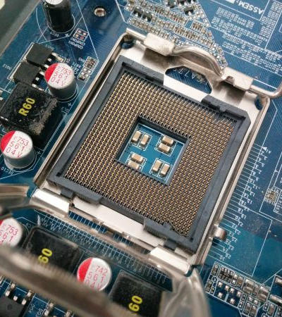
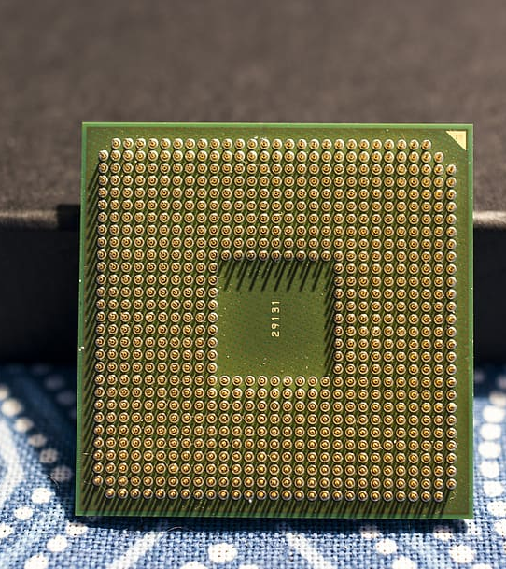

Slide 12
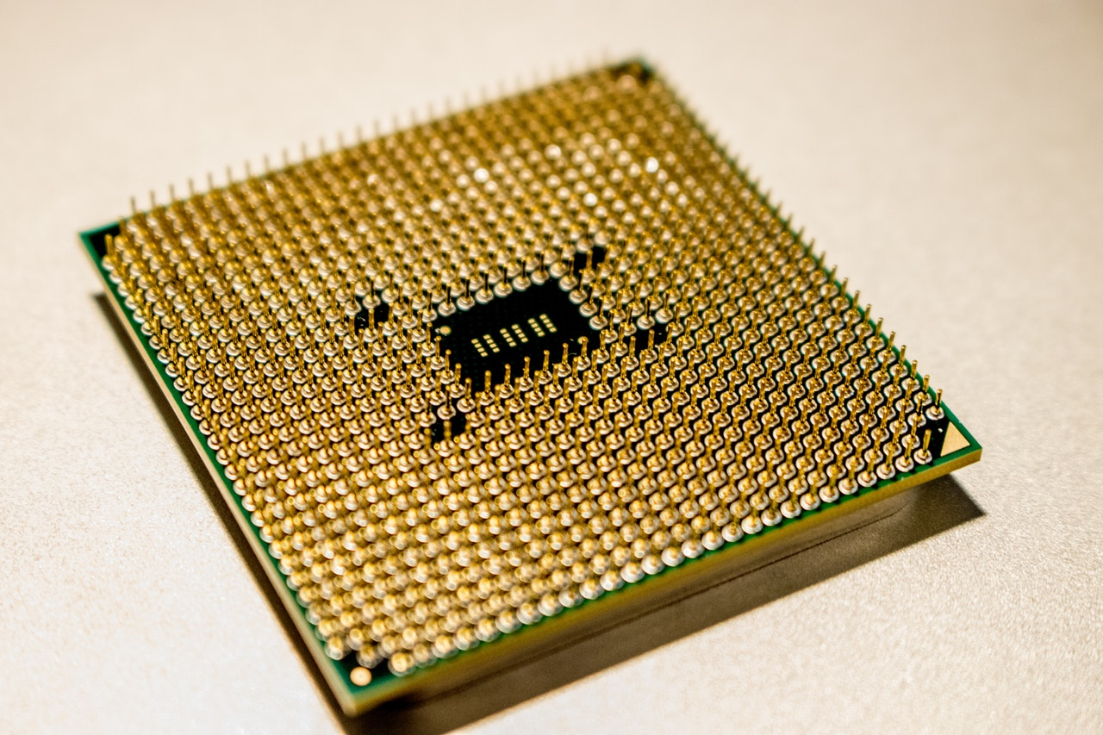
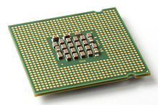
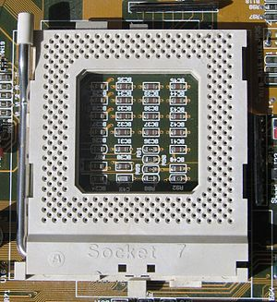
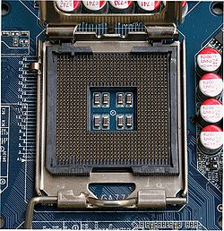
Processor Sockets
Pin grad array (PIN)
Land grad array (LIN)

Slide 13
Processor Sockets (AMD)
CPU Sockets Name
Used Processor family
STRX4
Ryzen Thread ripper 3000
TR4
Ryzen Thread ripper 2000 and 1000
AM4
Ryzen 3000, 2000 and 1000
FM2+
Used with the A10-, A8-, and a6-series of processors
FM2
Used with the trinity line of processors

Slide 14
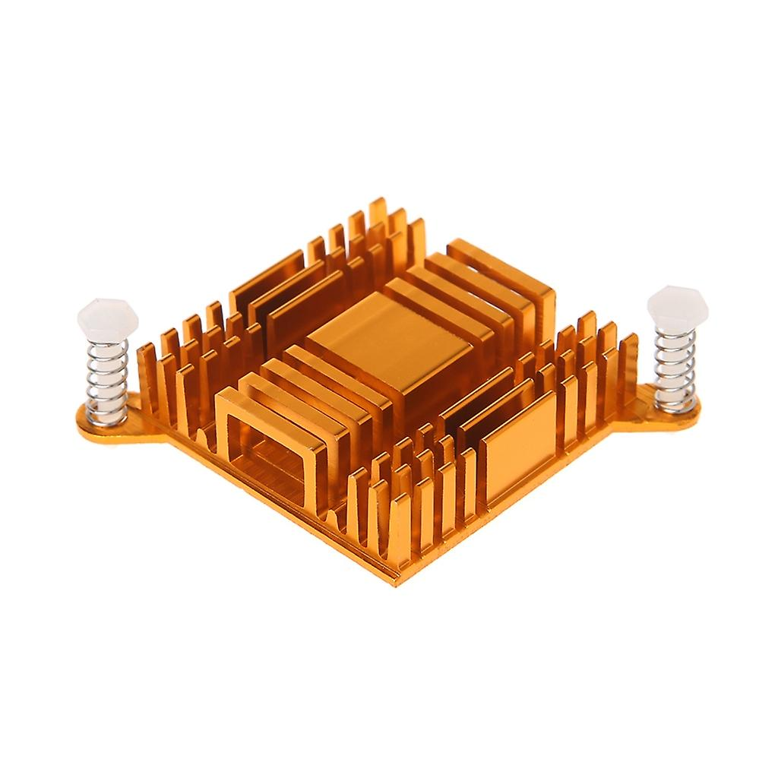
Chipsets
Manufacturer
Intel
AMD

Slide 15
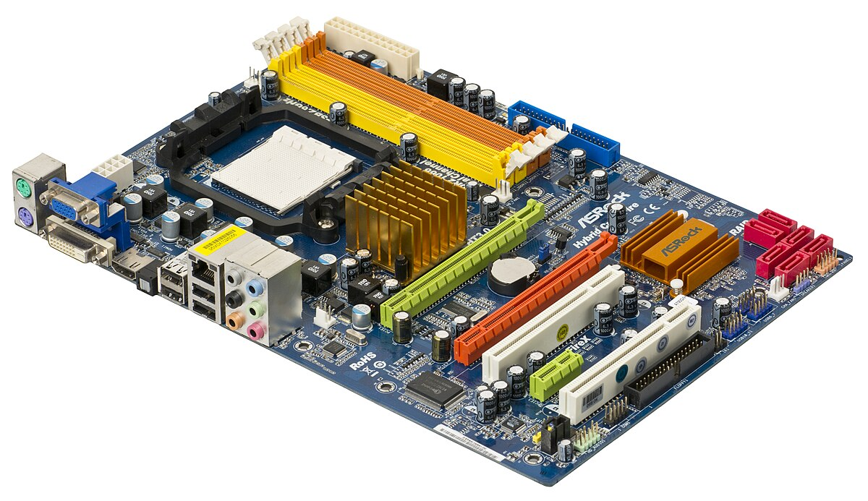
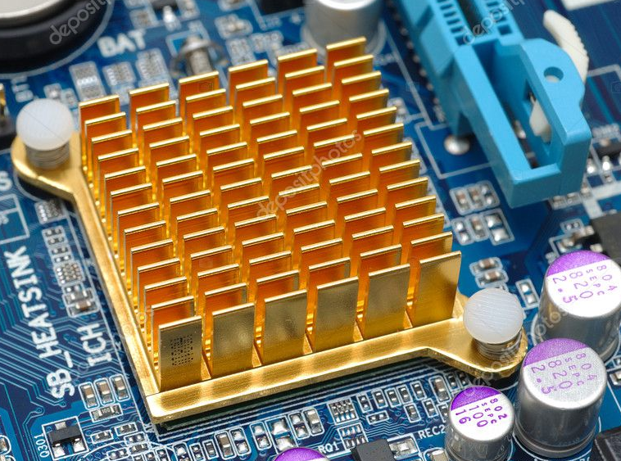
South bridge
North bridge

Slide 16
Chipsets Intel
North Bridge and South Bridge use a hub architecture
Intel i800 series of chipsets (start 2006)
hub using the Accelerated Hub Architecture

Slide 17
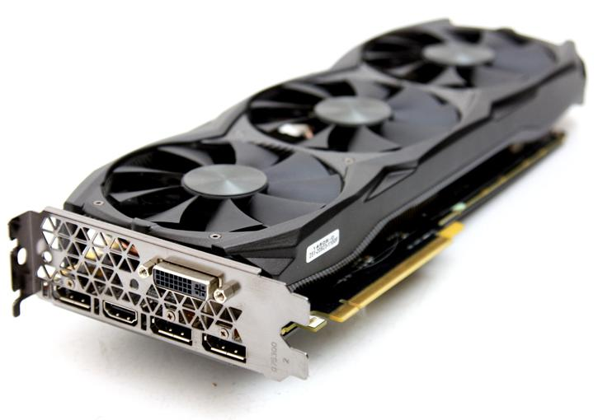
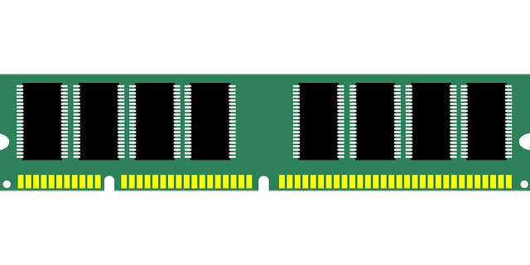

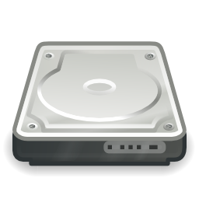
CPU
Front Side Bus(FSB)
64-bit Bus
North Bridge
Graphics/ Memory Controllers
Drives
PCIe Slot
PCIe Link
South Bridge
I/O Controller Hub(ICH)
PCIe Slot
PCIe Link
PCI Link
USB
Sound
PCI Slots

Slide 18

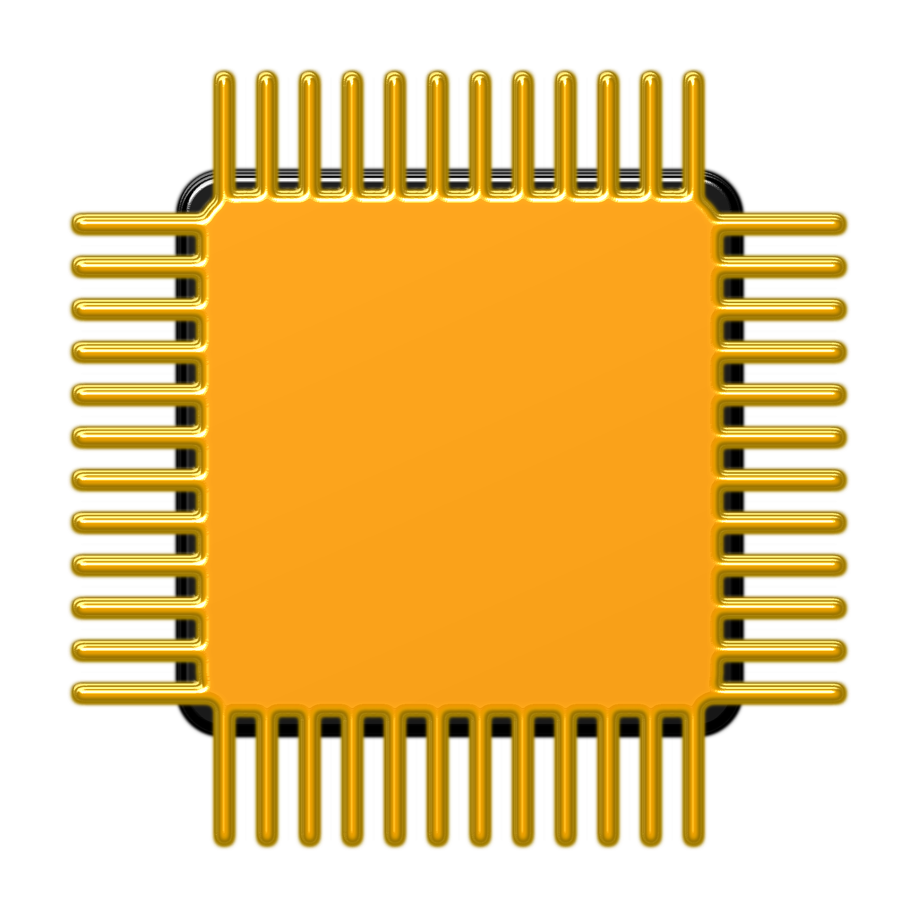
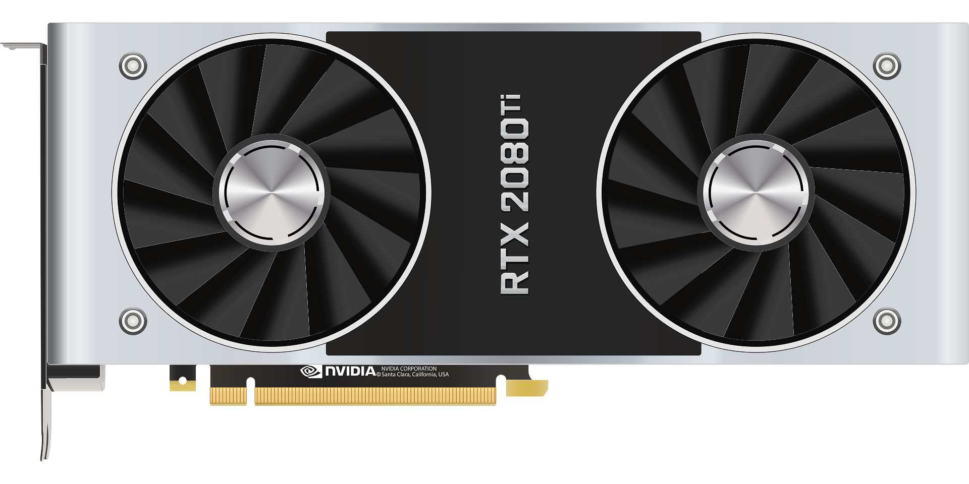
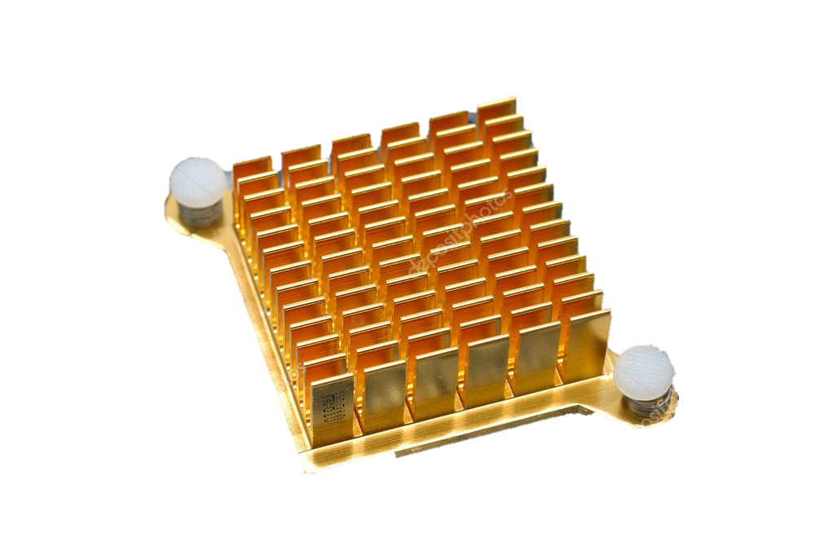
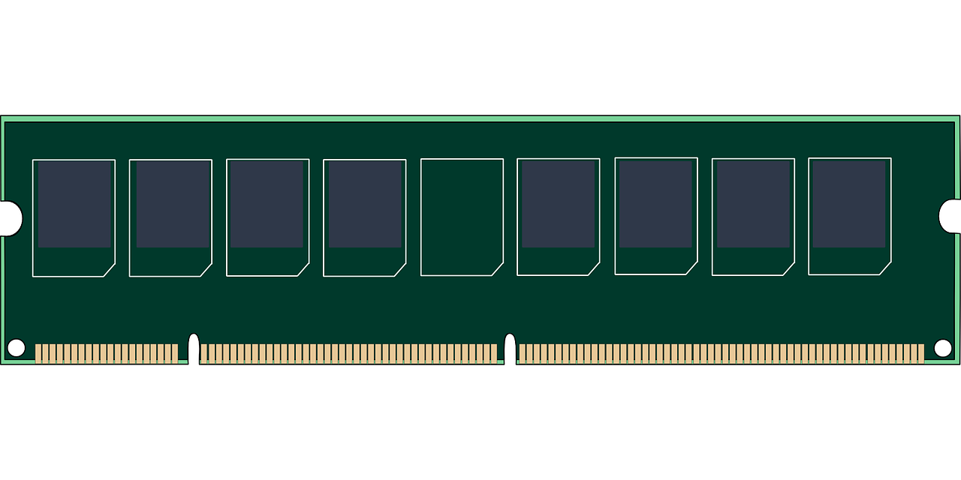





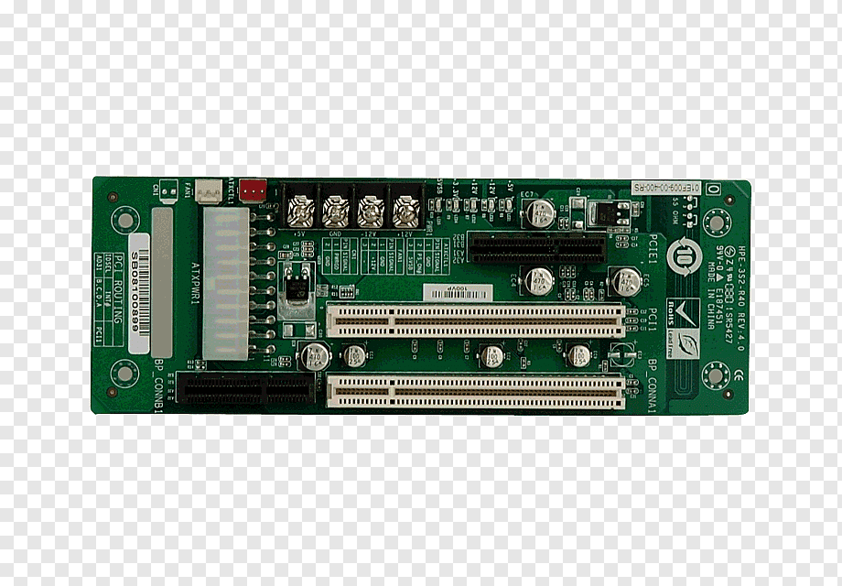
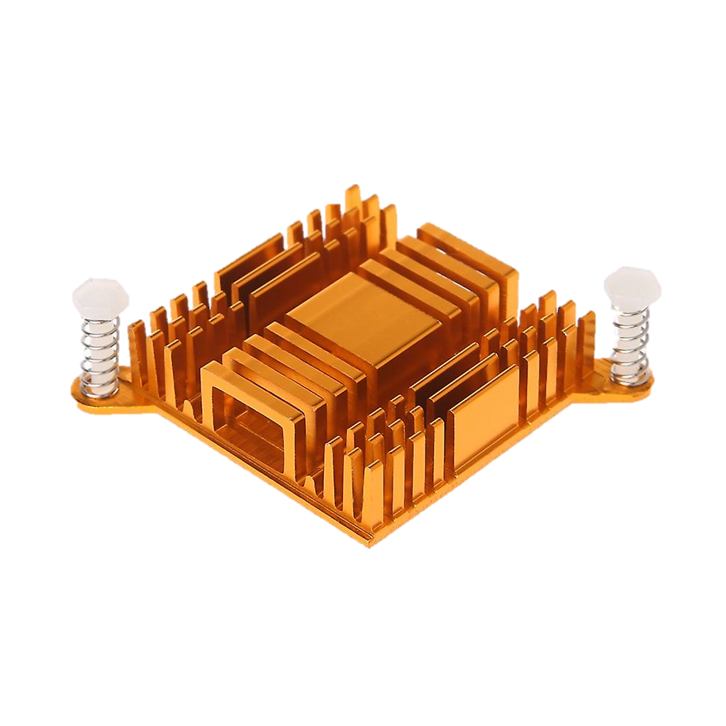

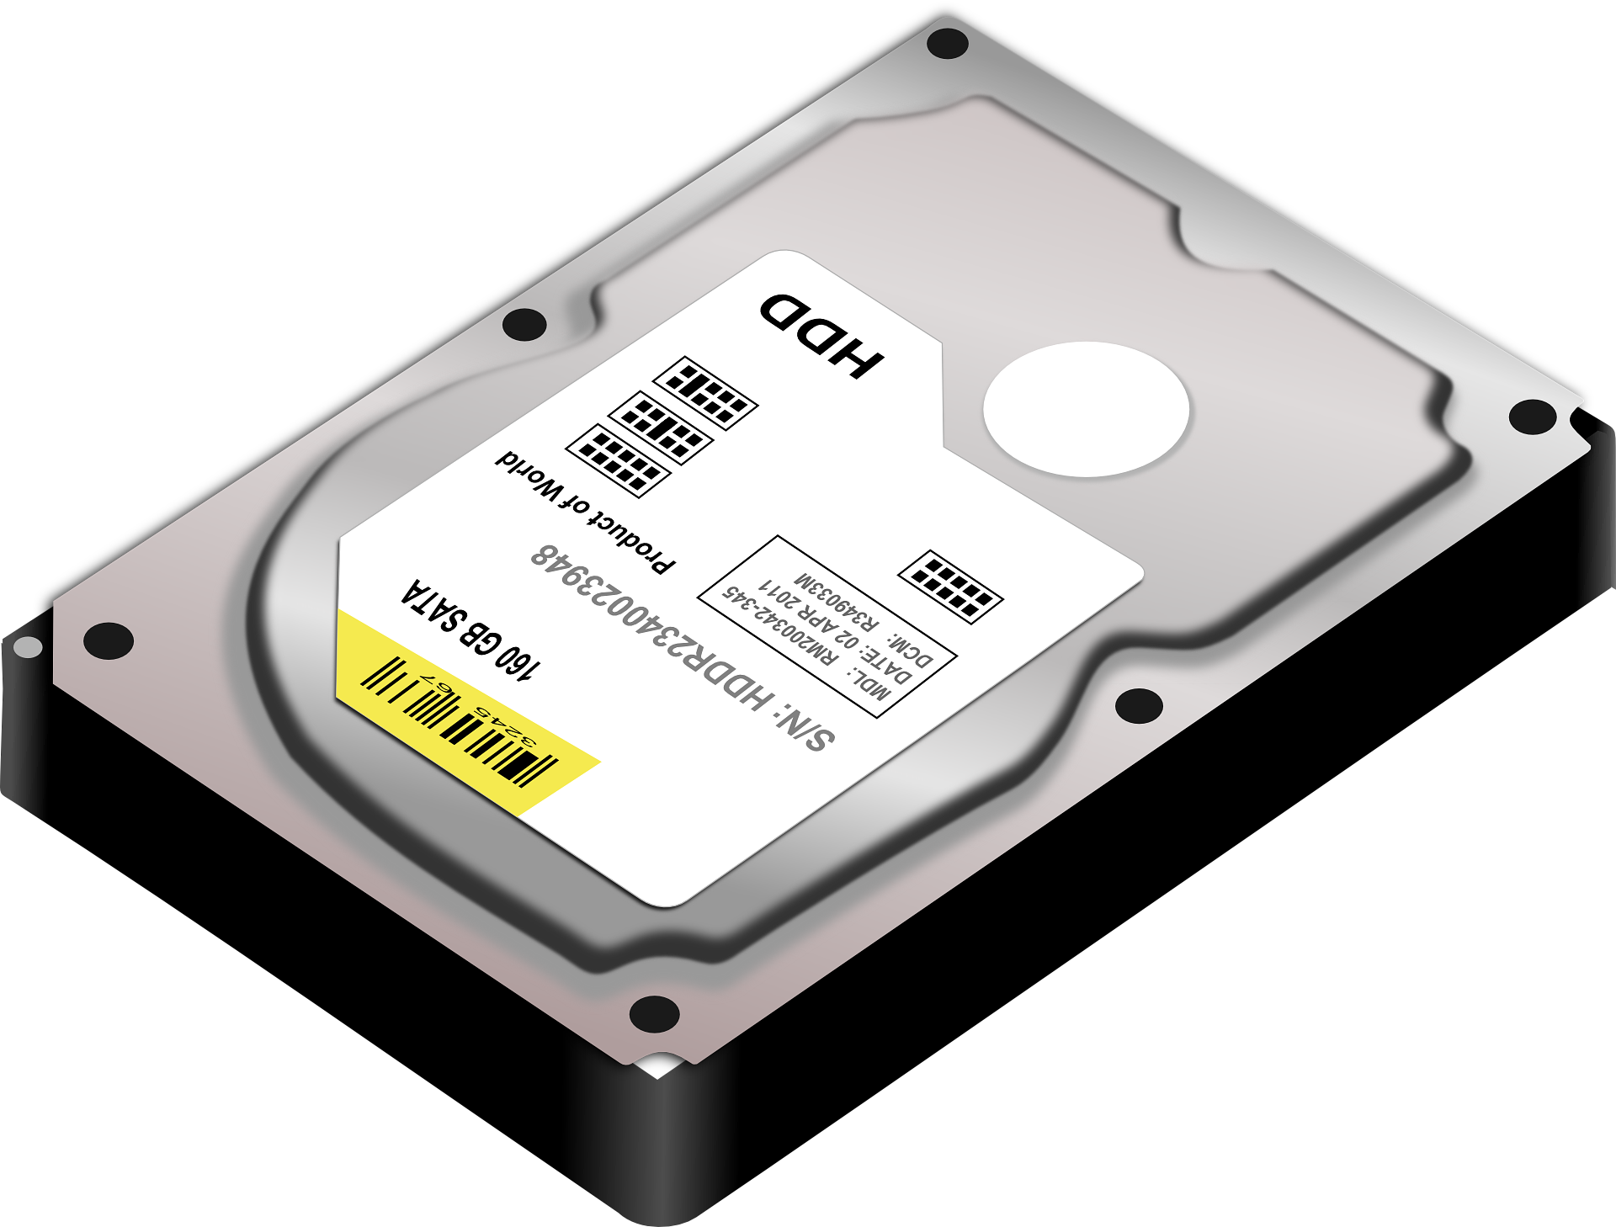


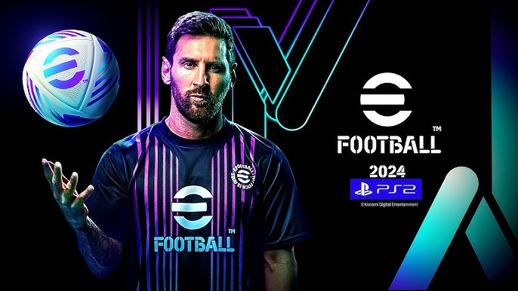



Slide 19
Chipsets Intel
Nehalem chipsets with the memory controller in the processor.
The release of the X58 chipset in 2008
The memory controller was contained in the processor housing
Nehalem chipsets support the Intel LGA1366 socket, the Core i7 processors, and PCI Express Version 2.
First generation

Slide 20
Nehalem chipsets with the memory controller in the processor.
CPU
Memory Controller
Quick Path Interconnect(QPI)
Front Side Bus(FSB)
64-bit Bus
North Bridge
Graphics/ Memory Controllers
Graphics Controller
Drives
PCIe Slot
PCIe Link
South Bridge
I/O Controller Hub(ICH)
PCIe Slot
PCIe Link
PCI Link
USB
Sound
PCI Slots

Slide 22
Intel Chipsets
Sandy bridge chipset with the memory and graphic control in the processor
Second generation

Slide 23
CPU
Direct Media Interface(DMI)
USB 2.0
Platform Controller Hub
(for example, the Intel X79
Express chipset)
High Definition Audio
Ethernet
PCIe 2.0
SATA, eSATA

Slide 25
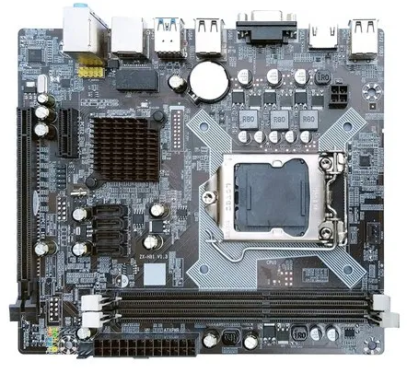

Slide 26
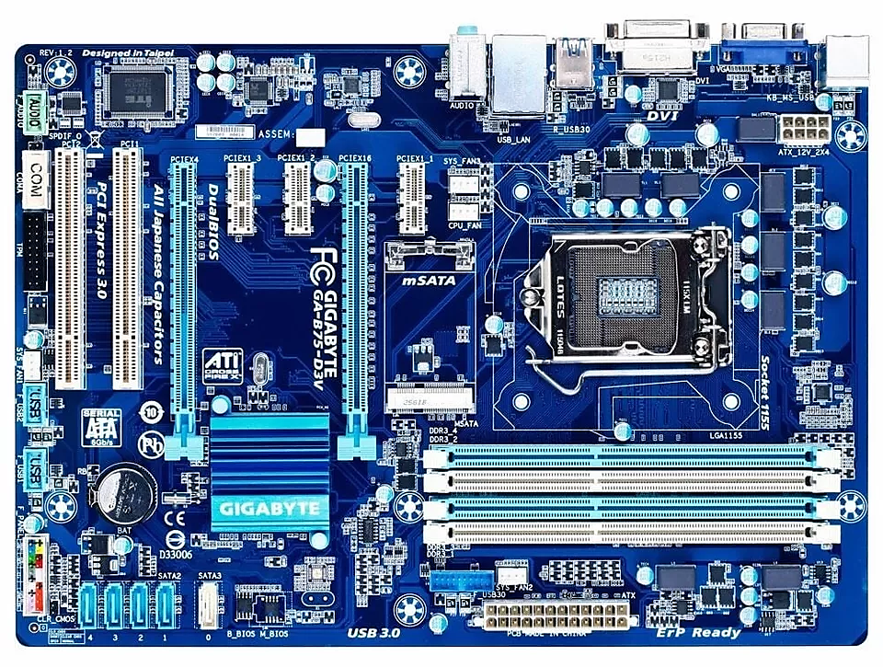
IVY bridge chipsets
Use less power
Squeeze more transistors into a smaller space
Perform better than earlier products.
Ivy Bridge chipsets include B75, Q75, Q77, H77, Z75, and Z77.
Third generation

Slide 27
Haswell Chipset
Forth generation
The fourth generation of Intel chipsets (Intel 8 Series), released in 2013, brought several advancements compared to the previous generation (Intel 7 Series). Here are the most significant developments:
1. Support for Haswell Processors:
2. Improved Power Efficiency:
3. Support for PCIe 3.0:
4. Storage Interface Improvements:
5. Full USB 3.0 Support:
6. Improved Integrated Graphics Performance:
7. Advanced Management and Control Technologies:
8. Support for Thunderbolt:
9. Improved Memory Support:

Slide 28
Broadwell Chipset
Fifth generation
The fifth generation of Intel chipsets (Intel 9 Series), released in 2014, brought several additions and improvements compared to the previous generation (Intel 8 Series). Here are the key additions:
1Support for Broadwell Processors:
2. Support for M.2 Ports:
3. Support for SATA Express:
4. Improved Integrated Graphics Performance:
5. Improved Power Management:
6. Improved Support for DDR3L Memory:
7. Enhanced Security Features:
8. Improved PCIe Speed:

Slide 29
Year
Generation Name
Name
Important Feature
2015
Sixth generation
Skylake intel 100 Series
Improved performance and power efficiency, 14nm.
2017
seventh generation
Kaby Lake intel 200 Series
4K support and noticeably faster storage speeds.
2018
eighth generation
Coffee Lake intel 300 Series
Increased cores and enhanced integrated graphics.
2019
ninth generation
Coffee Lake Refresh intel 400 Series
More cores and better power efficiency.
2020
tenth generation
Comet Lake intel 400 Series
Higher processor speeds with PCIe 3.0 support.
2021
eleventh generation
Rocket Lake intel 500 Series
PCIe 4.0 support and major graphics improvements.
2022
twelfth generation
Alder Lake intel 600 Series
Hybrid architecture with DDR5 and PCIe 5.0.
2023
thirteenth generation
Raptor Lake intel 800 Series
Improved performance with more cores and efficiency.
2024
fourth generation
Meteor Lake intel 900 Series
Chiclet architecture for enhanced performance and flexibility.

Slide 30
AMD Chipset
AMD specialize In Chipset and graphic processor called GPU
A serial Chipset
A serial chipset is a series of interconnected chips that manage and coordinate data flow between the CPU, memory, and peripherals in a computer system.
9 serial Chipset
Support eight core in processor

Slide 31

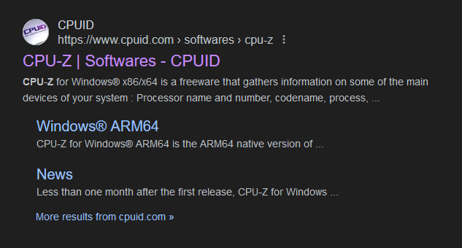
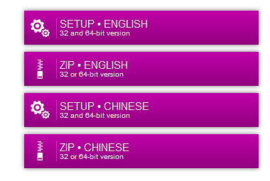
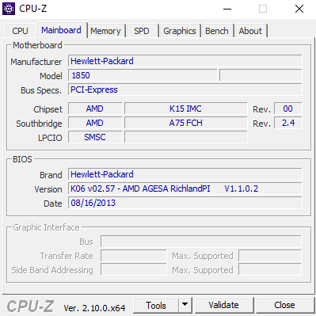


CPU Z

Slide 32

Tank you

